Slide 1

LOAN PREDICTION
MACHINE LEARNING PROJECT

Slide 2
MEMBERS
PRESENTED BY
JAYAKUMAR -9920004053 , SEC-D
NITHISH BALAJI -9920004093 , SEC-D
KAMALAKANNAN -9920004060 , SEC-D
PADMANABAN -9920004095 , SEC-D

Slide 3

CONTENTS
INTRODUCTION
SCOPE OF OUR PROJECT
MODELS USED
LIBRARIES
THE PROCESS OF MODELING THE DATA
ATTRIBUTES IN THE DATASET
REFERENCE
CONCLUSION
ABSTRACT

Slide 4
ABSTRACT
The number of applications that need an approval is increasing day by day.
So It is impossible to go through each application manually that need to get approved.
So we have developed a machine learning model that will predict the person who is eligible for a loan, based on the previous record of the person whom the loan amount is accredited before.

Slide 5
INTRODUCTION
Now a day’s people rely on bank loans to fulfil their needs. The rate of loan applications increases with a very fast speed in recent years.
Risk is always involved in approval of loans. The banking officials are very conscious about the payment of the loan amount by its customers.
Event after taking lot of precautions and analyzing the loan applicant data, the loan approval decisions are not always correct.

Slide 6
SCOPE OF OUR PROJECT
Our main scope from the project is to make use of pandas, matplotlib, & seaborn libraries from python to extract insights from the data and xgboost, & scikit-learn libraries for machine learning.
Secondly, to learn how to hypertune the parameters using grid search cross validation for the xgboost machine learning model.
And to predict whether the loan applicant can replay the loan or not using voting ensembling techniques of combining the predictions from multiple machine learning algorithms.

Slide 7


PROGRAMMING LANGUAGES :
PYTHON PROGRAMMING
PROGRAMMING PLATFORMS :
GOOGLE COLAB

Slide 8
MODELS USED
Decision Tree
Random Forest
XGBoost
Logistic Regression

Slide 9

LIBRARIES
numpy
pandas
matplotlib
Seaborn
sklearn

Slide 10
THE PROCESS OF MODELING THE DATA
Importing the model
Fitting the model
Predicting Loan Status
Classification report by Loan Status
Overall accuracy

Slide 11

DATASET :
LOAN PREDICTION DATASET
MODEL DATASET TAKEN PLATFORM
KAGGLE

Slide 12
ATTRIBUTES IN THE DATASET
Loan id
Gender
Married
Dependents
Education
Self Employed
Applicant income
Coapplicant income
Loan Amount
Credit History
Property_Area

Slide 13
DECISION TREE
RANDOM FOREST
XGBoost
LOGISTIC REGRESSION
TRAINING
DATA
DATA PREPROCESSING
AND CLEANING
MODELS
DATA
TESTING
DATA
BEST MODELS
CONTENT DIAGRAM
PREDICTION

Slide 14
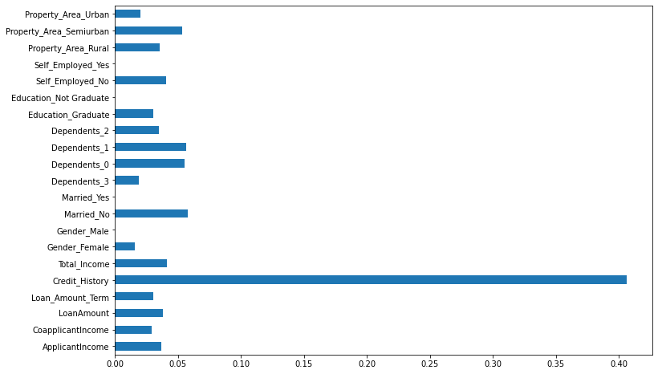
FEATURE IMPORTANCE

Slide 15
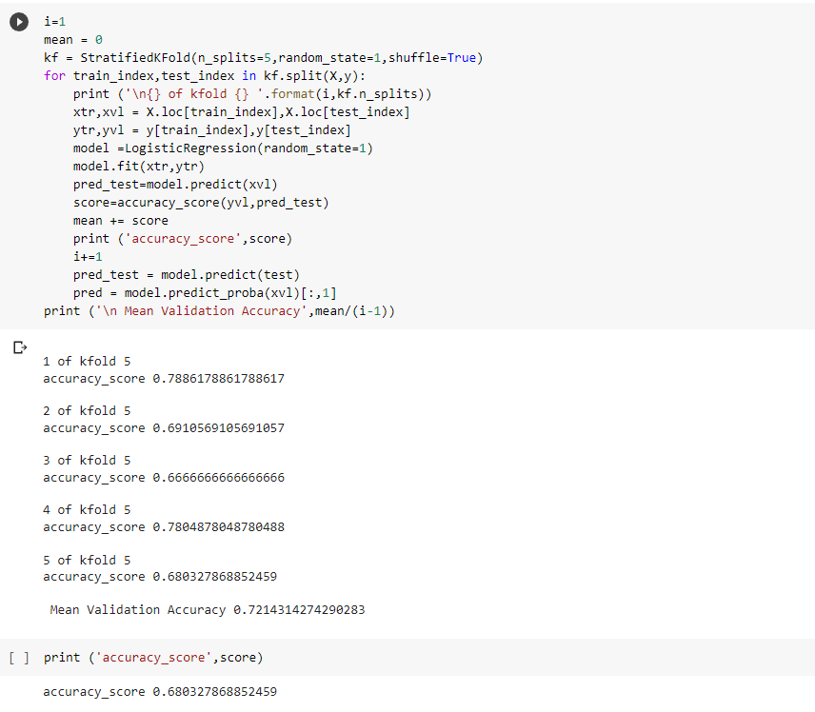
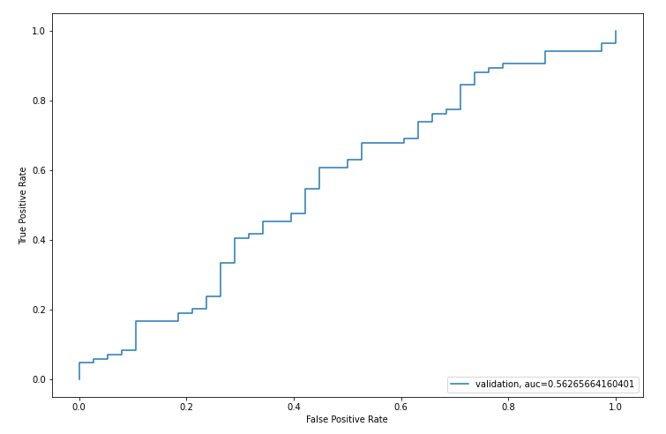
LOGISTIC REGRESSION:
Accuracy score : 0.6803

Slide 16
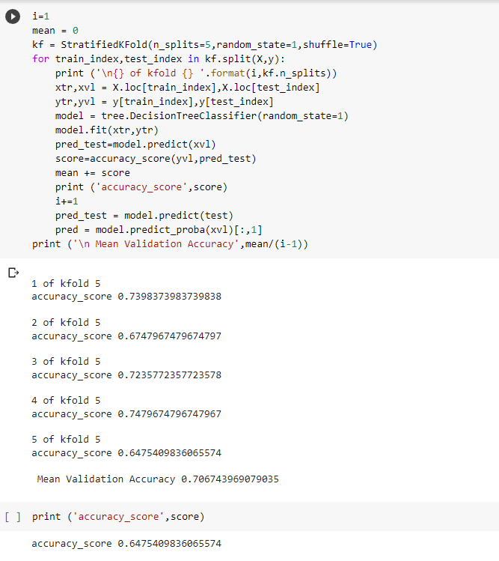
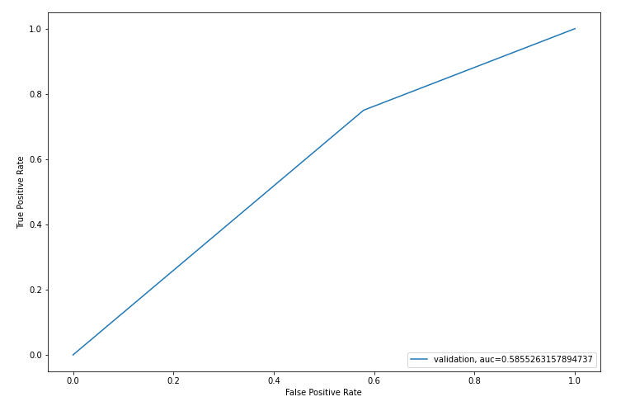
DECISION TREE
Accuracy score : 0.6475

Slide 17
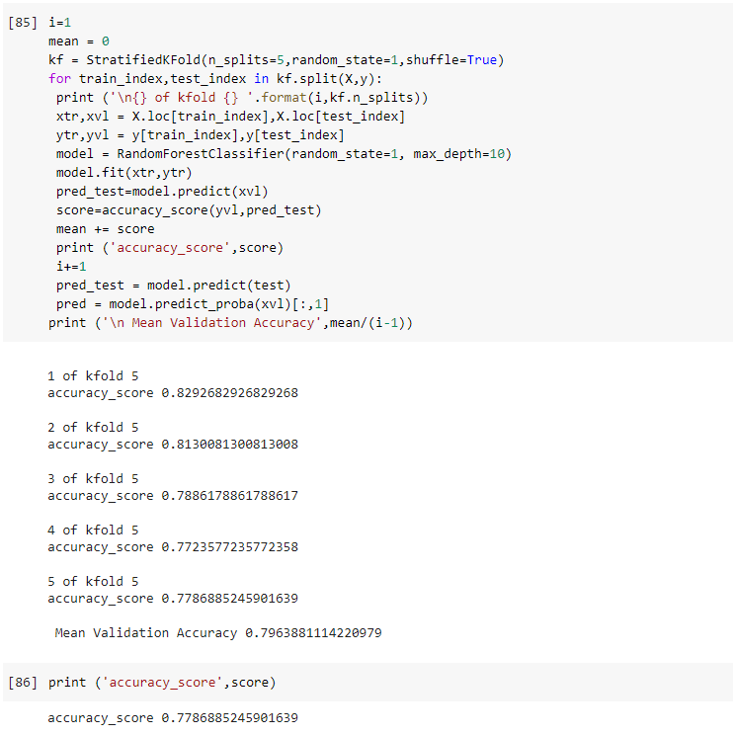
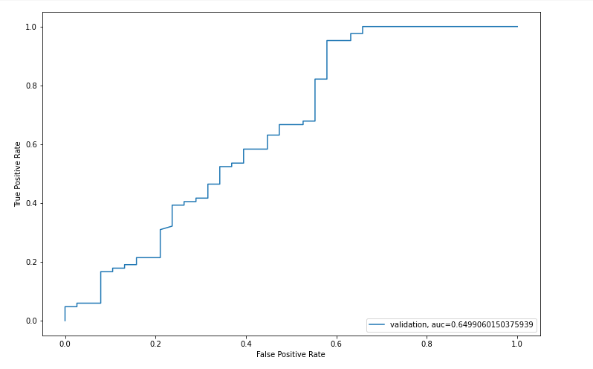
RANDOM FOREST
Accuracy score : 0.7786

Slide 18
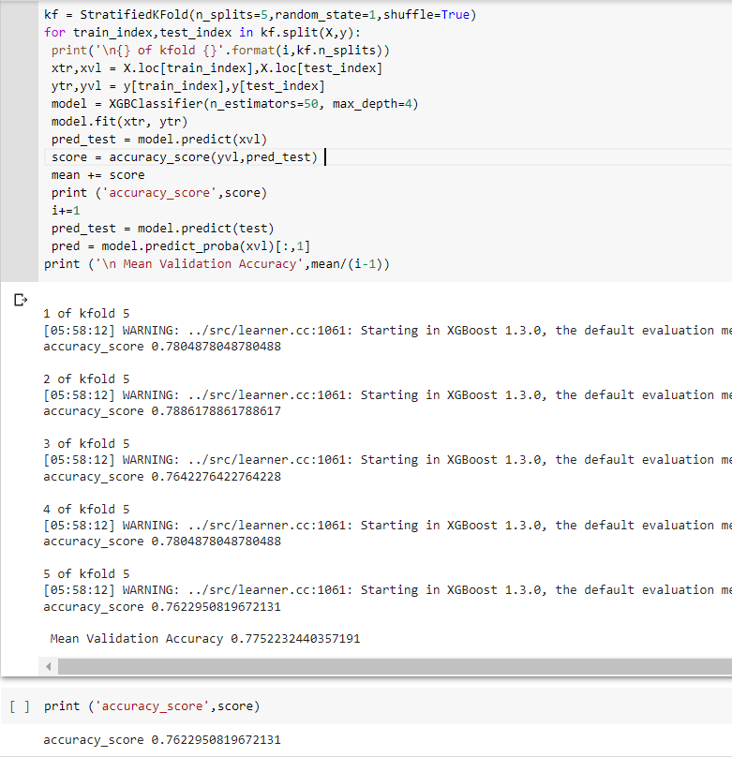
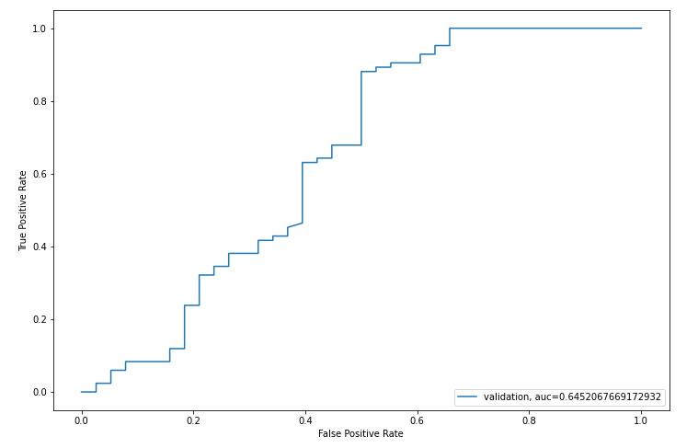
XGBOOST
Accuracy score : 0.7622

Slide 19
RESEARCH PAPERS
https://www.irjmets.com/uploadedfiles/paper/volume3/issue_1_january_2021/5540/1628083223.pdf
https://ieeexplore.ieee.org/abstract/document/9336801
http://www.ijetajournal.org/volume-3/issue-1/IJETA-V3I1P6.pdf
https://www.annalsofrscb.ro/index.php/journal/article/view/2818
https://www.kaggle.com/datasets/altruistdelhite04/loan-prediction-problem-dataset
REFERENCE
DATASET

Slide 20
CONCLUSION
We did Exploratory data Analysis on the features of this dataset and saw how each feature is distributed.
We calculated correlation between independent variables and found that applicant income and loan amount have significant relation.
We constructed models taking different variables into account and found it's odds ratio that credit history is creating the most impact on loan giving decision
We got good accuracy for all the four models

